Slide 1

Chapter 3: Cybercrime and cybercrime laws

Slide 2

Cybercrime
Cybercrime: A special category of criminal acts that are typically executed through the utilization of computer and network technologies
Cybercrime includes three basic categories:
Software Piracy: The unauthorized duplication of proprietary software and the distribution or making available of those copies over the network
Computer Sabotage: implies interference with computer systems, such as disruption of operations by means of malware.
Electronic break-ins: Unauthorized access to sensitive data, including cyber espionage.

Slide 3
Discussion 3.1 what is the best way to handle ransomware cases in your organization?

Slide 4
Computer-related crimes
Computer-related crimes: Traditional crimes that can be aided by the use of computers
Crimes can include:
Stalking
Theft (identity theft, fraud, swindling, or embezzlement)
Data leakage (trade secrets)
Phishing

Slide 5

Financial Crimes
Financial crimes are non-violent crimes that refer to any illegal act involving acquiring, transferring, or concealing financial assets to gain an unlawful advantage, deception, or breaking laws and regulations.
Cryptocurrencies have been labelled as the “Wild Wild West” where financial crimes are rampant.

Slide 6
Cryptocurrency-based Financial Crimes
Saha et al (2024) compiled a list of ten cryptocurrency-based financial crimes.
They believe that cryptocurrency’s anonymous transactions make it an attractive method for illegal activity

Slide 7
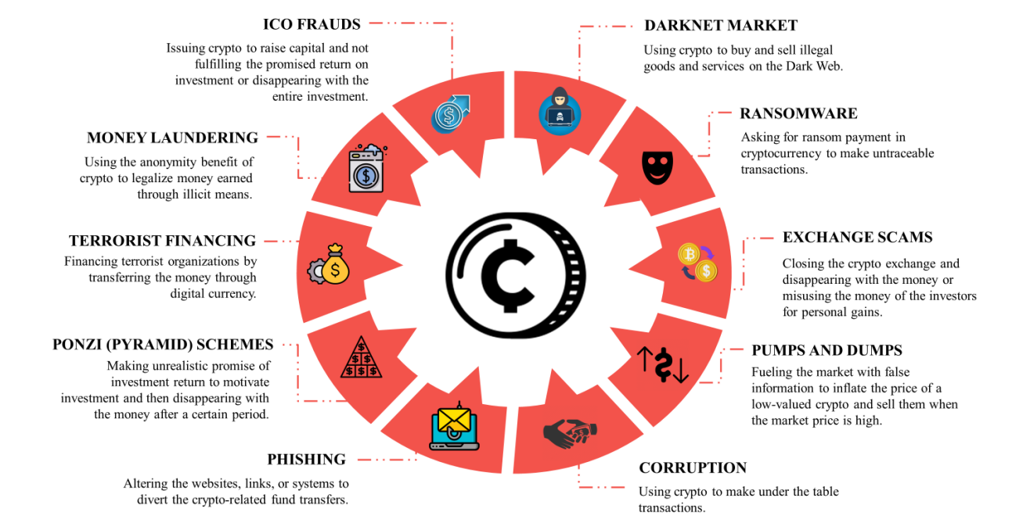

Slide 8
ICO Frauds
Initial Coin Offerings (ICO) Frauds: Are an initial offering that raises capital by selling cryptocurrency, usually by start-ups in the digital currency market. Examples of ICO Frauds are:
The firm issuing the ICO disappears after collecting money or guarantees an unrealistic return on investment to attract investment and eventually fails to do so (Bitconnect ICO 2017)
ICO issuing firms and their investors can be victims of fraud through phishing, hacking, or malware by cybercriminals (Olympic Games Token OGT 2024)
Notes:
The Bitconnect ICO case took place in 2017, with the platform launching its initial coin offering in December 2016. The ICO and subsequent operations attracted significant attention throughout 2017 as Bitconnect aggressively marketed itself as an investment platform offering guaranteed high returns.
Bitconnect reached its peak in late 2017, becoming one of the most infamous cryptocurrency platforms of the era. However, it began to unravel in early 2018 when authorities started investigating its activities, and the platform collapsed in January 2018.
Key dates in the Bitconnect case:
December 2016: Bitconnect launched its ICO.
January 2017: The platform officially went live.
2017: Bitconnect rapidly gained popularity, promising returns of up to 40% per month through its lending program.
January 2018: The platform was shut down following warnings from regulators in the United States and other countries.
The collapse of Bitconnect led to significant financial losses for investors, and it was later revealed to be a massive Ponzi scheme, resulting in multiple lawsuits and criminal investigations.

Slide 9
Money Laundering
Money Laundering: The process of legitimising the money earned through illegal transactions. The process involves three steps:
Placement: Money launderers purchase cryptocurrency through exchanges, P2P exchanges, or crypto ATMs
Layering: Launderers use unregulated exchanges to trade coins into different currencies and use mixers or tumblers to distort their location.
Integration: The “cleaned” funds are introduced into the legitimate economy. These funds are usually used to buy luxury goods or real estate. Cybercriminals may invest in legitimate businesses or services to make funds appear lawful.

Slide 10

Ponzi Scheme and Pump and Dumps
Ponzi Scheme: Also known as pyramid schemes, is where the fraudulent issuers of cryptocurrency circulate false information, make extensive marketing efforts, and offer tempting returns to lure investors into buying, selling, or converting coins and then disappear with the money.
Pumps and Dumps: The fraudsters circulate misinformation to increase the price of low-value coins and sell those coins to make profits, leaving investors who bought those coins at a high price. Example: Squid Game Token (SQUID) in 2021.

Slide 11
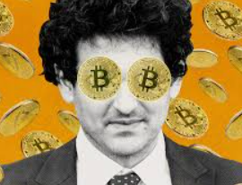
Exchange Scams
Exchange scams: Cryptocurrency exchanges engage in scams by closing the platform after investors buy coins through that exchange.
FTX was one such exchange that defrauded its investors by misusing funds and moving funds across various entities owned by Sam Bankman-Fried, the owner of FTX and Alameda Research.
While FTX did not close and disappear with the funds, it misused the funds of its investors, which led to its bankruptcy.
Bankman-Fried was sentenced to 24 years in prison in 2024.

Slide 12

Darknet Market and Terrorist Financing
Darknet market: Cryptocurrency has become a popular payment method in the darknet market for illegal services such as dealing with illegal drugs and substances, human trafficking, illicit trafficking of protected goods, and counterfeit documents
Terrorist Financing: Terrorists and their financiers use cryptocurrency to receive, transfer, and spend funds

Slide 13
Ransomware and Phishing
Ransomware: Ransomware is a kind of malware designed to attack an individual or organization’s system or computer to take control of that system and deny access to the owner. Hackers threaten to disclose private information or destroy valuable data until victims fulfill ransom demands, usually in digital currency
Phishing: Scammers create fake websites, links, emails, or social media accounts that closely resemble the official version and, therefore, are difficult to differentiate. The fraudsters use various methods to distribute these false gateways. They use malware, social media marketing, and search engines to replace the original gateways.
Phishing is common during ICOs. In 2017, when CoinDash started its public ICO phase, attackers changed official wallet addresses and collected 43,000 ETH in seven minutes until CoinDash shut down its website.

Slide 14

Corruption
Corruption: Cryptocurrency involves corruption-related fund transfers (such as bribery). Both parties involved in such transactions have a wallet, and they can avoid detection by ensuring that their e-wallets are inaccessible to others. Later, they can convert this cryptocurrency into cash through money laundering.

Slide 15
Rational Choice Theory
Rational Choice Theory:
The rational choice theory in criminology dictates that if a crime is profitable and has low risks, an individual could rationalize doing it.
This theory is one of the older theories, as it originated in the 18th century through the works of Cesare Beccaria, but is still applicable to modern-day crimes.

Slide 16
Rational Choice Theory
Cybercrimes require no physical contact or confrontation with the involved parties, and an overall lack or lag of regulations around crypto trading has made it lucrative for individuals with criminal intent.
As long as the crime (fraud or Ponzi scheme, money laundering services) is profitable, it makes more rational sense to use cryptocurrency if the chance of being caught is lower since cryptocurrencies have robust anonymity features
Rational choice, in this case, relies on the perception of the investor, not grounded in objectivity. A cryptocurrency investor with high-risk tolerance and overconfidence is more likely to rationalise engaging in criminal activities with cryptocurrency to maximise their gains.

Slide 17
Convenience Theory
The convenience theory of white-collar crimes put forward by Gottschalk explains that convenience in three dimensions works to enable white-collar crime:
The economic dimension: Which is the desire to profit financially from committing the crime
The organizational dimension: Where criminals have strategic positions in the organization or the hierarchy, gives them more access to resources and more control to commit these crimes. For example, pump and dump scams
The behavioral dimension: Criminals can easily justify their actions and rationalize crimes so that they are not guilty about committing them.

Slide 18
Social Learning Theory
According to social learning theory, individuals can engage in crime or cybercrime by witnessing the behavior or actions of others.
The activities of the crypto trader communities give the impression that market abuse and losing investments in a flash are normalized, and the responsibility falls to the individual to look out for themselves in a trade
It is easy for newcomers who could be followers of a similar individual responsibility and profit by any means mindset to mimic the behaviours of others and participate in scams and other crimes, whether knowingly or unknowingly.

Slide 19
Space Transition Theory
Space transition theory suggests that people with a repressed or overt tendency to commit crimes in real life are also likely to commit crimes in virtual space due to the anonymity and likelihood of forming bonds with similar tendencies.
This makes intuitive sense since many people seeking anonymity and needing more governance in financial transactions could be barred from doing so in traditional financial institutions.
There could be strong self-selection bias where cryptocurrency is used for illicit financing and crimes because it is used by unsavoury individuals who have already committed those crimes in real-world space.
So, it is unsurprising that real-world money launderers and scammers would start to show in the virtual space to use cryptocurrency for such activities.

Slide 20

Bahrain’s Cyber Crime Legislations
Law No 30 of 2018 regarding Issuing the Protecting Personal Data Law
Law No. 2 of 2017 for Ratifying the Arab Agreement on Combating IT Crimes
Law No. 60 of 2014 regarding Information Technology crimes
Law No. 16 of 2014 regarding the Protection of Information and State Documents
Decree-law No. (54) for the year 2018 for Issuance of Letters and Electronic Transactions
Decree of the Prime Minister No. 36/2018 regulating the technical requirements for sending, receiving, and updating the electronic records and signatures of the public bodies

Slide 21
Law No. 60 of 2014 regarding Information Technology crimes
Introductory Chapter:
As this law describes crimes and their corresponding penalties, it is essential to define elements such as Information technology, Information, Information technology tool, system, and data.
Chapter One: Penalties for IT crimes
Section One: Crimes against the IT tool’s systems and data
Section Two: Crimes related to IT tools
Section Three: Crimes related to content
Chapter Two: Procedures for IT Crimes
Chapter Three: Miscellaneous Provisions

Slide 22
Chapter One: Penalties for IT crimes (Section 1: Cybercrimes)
Article (2) Electronic break-in: No more than 1 year imprisonment and a fine not exceeding thirty thousand dinars or one of these two penalties. If break-in results in disclosure of data, this shall be considered as an aggravating circumstance.

Slide 23
Chapter One: Penalties for IT crimes (Section 1: Cybercrimes)
Article (3) Computer Sabotage: Subjected to imprisonment (up to 3 years) and a fine not exceeding fifty thousand dinars, or either of these two penalties. Penalty is doubled if the crime results in:
Impediment of the conduct of any public facilities or public interest
Threat to people’s lives, security, or health
Causing bodily harm
Tampering or deletion of medical examinations, diagnosis, or treatment
If the crime committed involves the intentional death of a person, the penalty is life imprisonment or a determinate term of imprisonment (over 3 years)

Slide 24
Chapter One: Penalties for IT crimes (Section 1: Cybercrimes)
Article (4) Spying: Subject to imprisonment (up to 3 years) and a fine not exceeding one hundred thousand dinars, or either of these two penalties. If the eavesdropping results in disclosure without legal justification, it shall be considered an aggravating circumstance.
Article (5) Blackmailing/ Ransomware: Subject to imprisonment (up to 3 years) and a fine not exceeding thirty thousand dinars, or either of these two penalties. If the offender reaches his objective, imprisonment should not exceed five years, and a fine not exceeding sixty thousand dinars.

Slide 25
Chapter One: Penalties for IT crimes (Section 1: Cybercrimes)
Article (6) Facilitating an IT crime: By producing, importing, buying, selling, offering to sell or use, distributing, circulating, possessing, publishing, or freely distributing:
A tool, including any software, to commit an IT crime
Any password or access to an IT system
The penalty is imprisonment not more than one year, and a fine not exceeding 100 thousand dinars or either of these two penalties.

Slide 26
Chapter One: Penalties for IT crimes (Section 2: Crimes related to IT tools)
Article (7) Cybercrimes against government agencies: Any person who installs, denatures, deactivates, cancels, deletes, destroys, alters, modifies, distorts or obscures data owned by a government department will receive a penalty of imprisonment not exceeding ten years.
Article (8) Fraud: Anyone who seizes money from others, or obtains any advantage for himself or for others by the following means:
installs, denatures, deactivates, cancels, deletes, destroys, alters, modifies, distorts or obscures data receives a penalty of up to three years of imprisonment

Slide 27
Chapter One: Penalties for IT crimes (Section 2: Crimes related to IT tools)
Article (9) Encryption: A penalty of imprisonment (up to three years) and a fine not exceeding 100 thousand dinars, or either of these two penalties, shall be imposed on any person who uses encryption to commit or hide any offence.

Slide 28
Chapter One: Penalties for IT crimes (Section 3: Crimes related to content)
Article (10) Pornography: A penalty of imprisonment (1-3 years) and a fine not exceeding ten thousand dinars, or either of these two penalties for:
Producing pornographic content
Import, sale, offer for sale or use, exchange, transfer, distribution, sending, publishing, or making available via IT systems (minimum 2 years imprisonment if children are targeted)
A minimum of three months imprisonment and a fine not exceeding three thousand dinars, or either of these two penalties for those:
Obtaining pornographic content
Possessing pornographic content and the penalty is doubled if intended for children or placed within their reach

Slide 29
Chapters Two and Three
Chapter Two: Procedures for IT crimes Describes the steps needed to be taken by the Public Prosecution and the judges of the lower court to ensure a fair trial.
Chapter Three: Miscellaneous Provisions
Article (20): Attempts to commit the crimes shall be punished by half the penalty of the full crime
Article (22): Allows intangible items such as data, software, and electronic documents to be referred to as “things”, which is a term used for tangible items.

Slide 30
Summary
Cybercrime includes sabotage, break-ins, financial fraud, and crypto-enabled crimes.
Cryptocurrencies amplify risks through anonymity and global reach.
Criminological theories explain why offenders migrate to cyberspace.
Bahrain’s IT Crimes Law defines clear offences and penalties.
Critical Reflection
Can law keep pace with evolving cybercrime methods?
Should anonymity always be preserved if it enables crime?

